Slide 1
Grocery Genius: Smart Grocery Shopping Assistant with Basket Analysis
204M1A04A4 204M1A0474
R SASI KUMAR ACHARI M MANJUNADHA
204M1A0463
K KOUSHIK KUMAR REDDY

Slide 2
INTRODUCTION:-
A Smart Grocery Shopping Assistant with Basket Analysis utilizes technology to enhance the shopping experience.
It offers personalized recommendations, real-time suggestions, and analyzes shopping baskets to understand customer behavior.
This data-driven approach helps optimize inventory, tailor promotions, and improve overall customer satisfaction.
while providing valuable insights to retailers for better decision-making.

Slide 3
IMPORTANCE AND APPLICATION:
The Smart Grocery Shopping Assistant with Basket Analysis is crucial in retail and e-commerce for personalized recommendations.
optimizing inventory, and enhancing customer experience.
It enables targeted marketing, efficient operations, and strategic upselling, ultimately fostering customer loyalty.
providing a competitive edge through data-driven insights into shopping behaviors and preferences.

Slide 4
OBJECTIVE OF THE PROJECT:-
Personalized Recommendations:- Provide tailored product suggestions based on individual shopping habits and basket contents.
Optimized Inventory Management:- Analyze basket data to optimize inventory levels, reduce wastage, and ensure popular items are adequately stocked.
Enhanced Customer Engagement:- Improve customer satisfaction by offering relevant promotions, discounts, and product bundles based on basket analysis.
Operational Efficiency:-Streamline store operations by understanding customer preferences and optimizing layout, staffing, and checkout processes.
Data-Driven Decision Making:- Enable retailers to make informed decisions on pricing, marketing strategies, and product assortment based on comprehensive basket analysis insights.

Slide 5
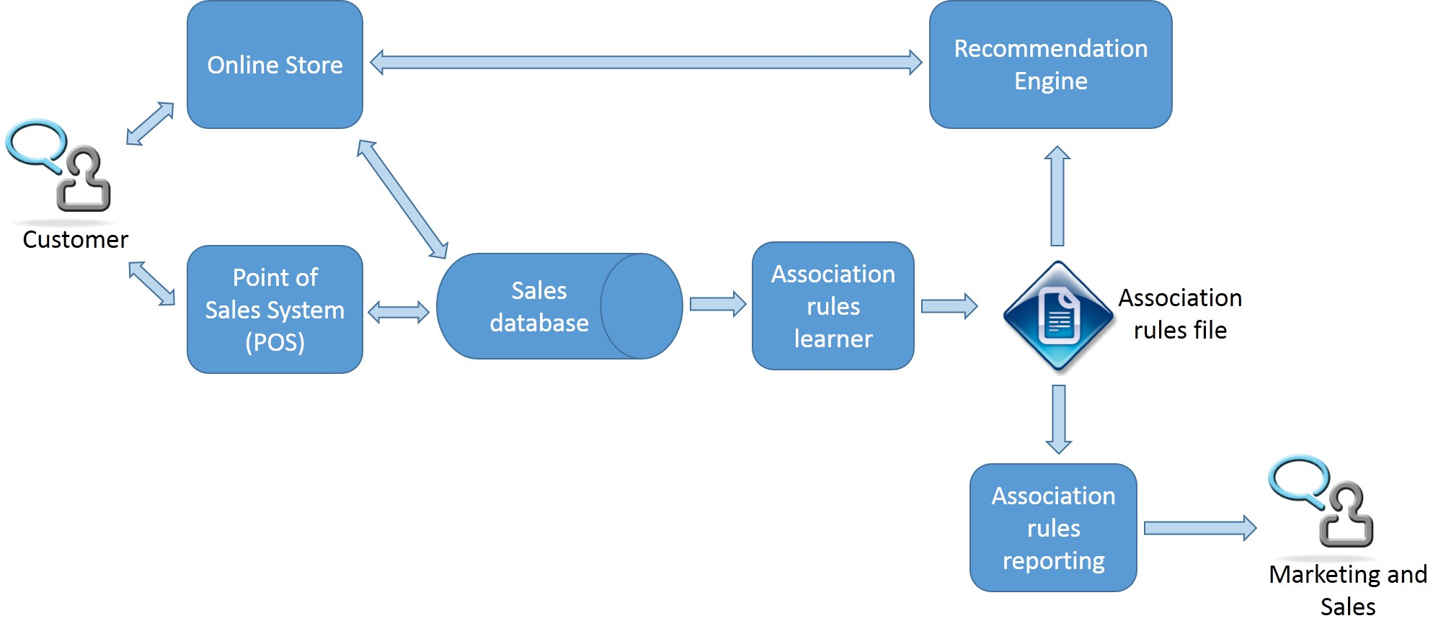
DATA DESCRIPTION:- sample transaction data structure

Slide 6
IMPLIMENTATION:- tools and technologies used:-
Python library like pandas, mlxtend and
For Database management system SQL
For data collection kaggle

Slide 7
ASSOCIATION RULES:-
Introduction: Briefly explain the purpose of the analysis and the dataset used.
Key Metrics: Highlight key metrics like support, confidence, and lift that were used to evaluate the association rules.
Top Rules: Present a few impactful rules with high support and confidence, focusing on meaningful item combinations.
Visualization: Use visual aids like tables or charts to illustrate the rules and their metrics.
Interpretation: Provide concise interpretations of the rules and their implications for product placement or marketing strategies.
Recommendations: Suggest actionable recommendations based on the insights gained from the association rules.
Conclusion: Summarize the findings and emphasize the value of the analysis for optimizing business decisions.

Slide 8
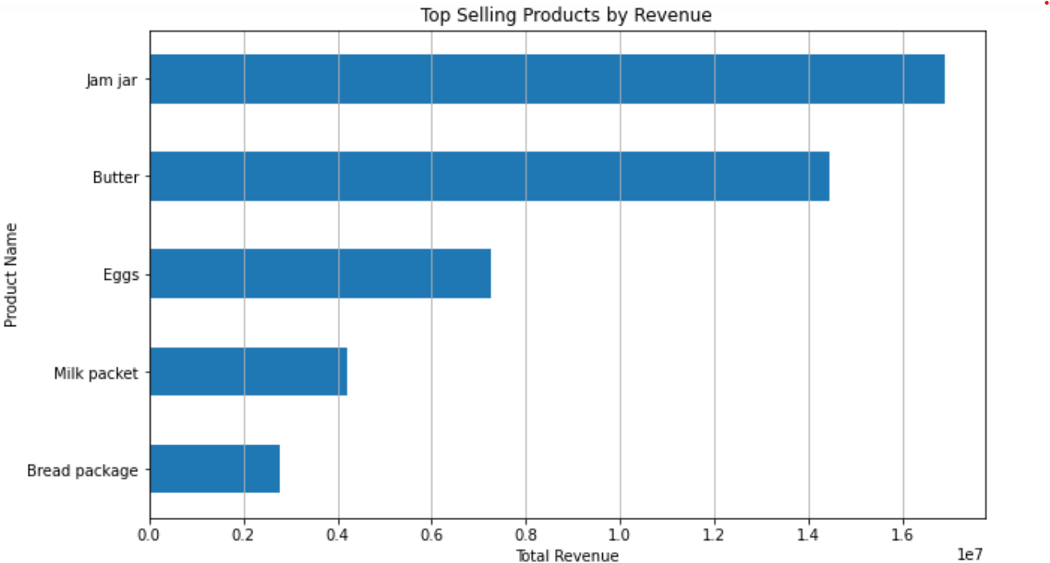
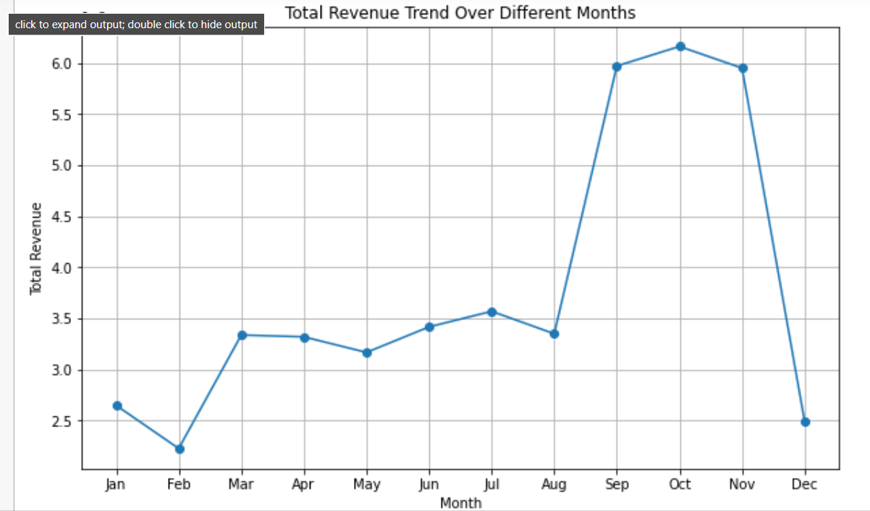
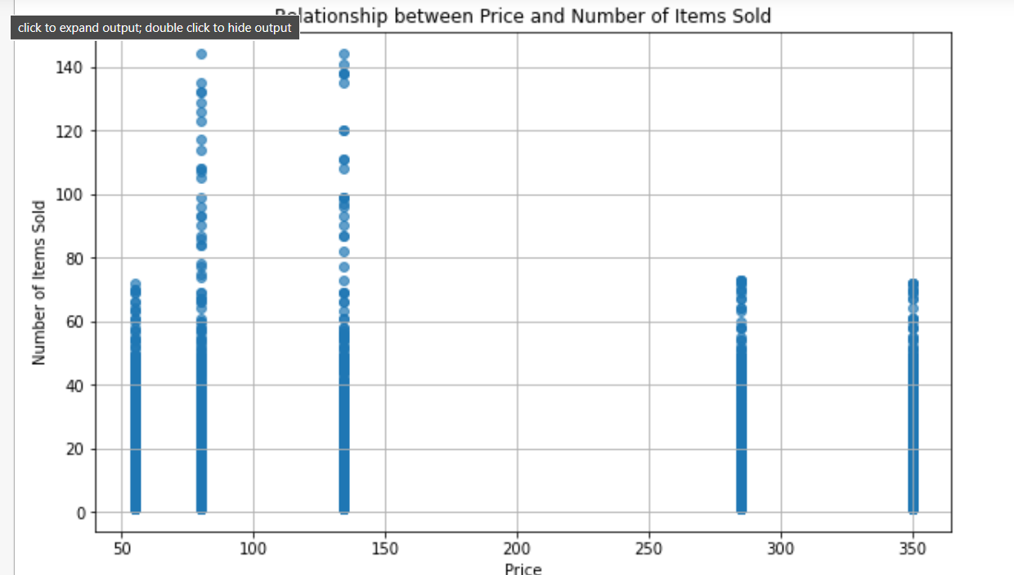
INSITES & VISUALIZATION:-

Slide 9
LIMITATIONS & SUGGESTION
By observing the insites of customer purchasing behavior by identifying relationships between products frequently purchased together.
This analysis can guide retailers in optimizing product placement, promotions, and cross-selling strategies.
However, it has limitations such as the inability to explain why certain products are purchased together, its sensitivity to outliers or infrequent items, and the challenge of interpreting results without context or additional data on customer preferences or demographics.
It's also important to note that market basket analysis is most effective with transactional data and may not capture more complex customer behaviors or evolving trends without supplementary techniques.

Slide 10
CONCLUSION:-
In conclusion, this market basket analysis project has provided valuable insights into customer purchasing patterns and product associations within our dataset.
By identifying frequently co-occurring items, we have uncovered actionable strategies for optimizing product placement, cross-selling opportunities, and targeted marketing campaigns.
However, further exploration could enhance our understanding by considering additional factors such as customer demographics and seasonal trends.
Overall, leveraging market basket analysis has proven instrumental in driving data-driven decision-making and enhancing the overall customer experience.

